Slide 1
Configure a Firewall in Linux

Slide 2
INTRODUCTION
Securing your Linux system is paramount in today's digital landscape, and a firewall is your first line of defense against unauthorized access and malicious activities. Configuring a firewall in Linux involves setting up rules that control incoming and outgoing network traffic, ensuring only legitimate connections are permitted while blocking potential threats.
In this presentation, we will explore the essentials of configuring a firewall on a Linux system. We'll cover the primary tools and techniques used, best practices for rule management, and strategies for monitoring and maintaining firewall effectiveness. By the end, you'll have a solid understanding of how to implement a robust firewall solution to protect your infrastructure.

Slide 3
What is a Firewall
A firewall is a security system designed to monitor and control incoming and outgoing network traffic based on predetermined security rules. It acts as a barrier between a trusted internal network (like a company's private network) and untrusted external networks (like the internet). Firewalls can be hardware devices, software programs, or a combination of both, and they play a crucial role in preventing unauthorized access to or from private networks while allowing legitimate communication to pass through.
Hardware Firewall
Hardware firewall is positioned between the network and devices, allowing traffic to funnel through the firewall for a close inspection and analysis. A hardware firewall, a term often interchangeable with network or next-generation firewall, protects the network gateways for an enterprise.
Software Firewall
Software firewall is a firewall that is installed on a computer or server, and tasked with network security. It works with a wide variety of other technology security solutions to provide more robust and cohesive security for enterprises of all sizes.

Slide 4
Types of firewall
Packet Filtering Firewall: Examines packets of data and filters them based on predetermined criteria (e.g., IP addresses, port numbers).
Stateful Inspection Firewall: Keeps track of the state of active connections and only allows packets that are part of an established connection.
Proxy Firewall: Acts as an intermediary between internal and external networks, handling requests on behalf of clients.
Next Generation Firewall (NGFW):Deep packet inspection Firewall with application-level inspection.
Circuit-Level Gateways: Circuit-level gateways are another simple firewall type meant to quickly and easily approve or deny traffic without consuming considerable computing resources.
Importance of Firewalls
Enhances Network Security: Prevents unauthorized access and protects sensitive data.
Controls Network Traffic: Filters and blocks malicious or unwanted traffic.
Enforces Network Policies: Implements rules for acceptable use and access control.

Slide 5
FIREWALL TERMINOLOGY
Packet filtering: A firewall technique that examines packets (data units) as they pass through the firewall and blocks or allows them based on pre-established rules.
Stateful inspection: A firewall technique that tracks the state of network connections to enforce security policies, which can be more effective than packet filtering.
Application firewall: A firewall that monitors and filters incoming and outgoing traffic for specific applications or protocols to prevent unauthorized access.
Intrusion Detection System (IDS): A security system that monitors network traffic for signs of malicious activity, such as unauthorized access or network attacks.
Intrusion Prevention System (IPS): A security system that monitors network traffic and actively blocks or prevents malicious activity.

Slide 6
Demilitarized Zone (DMZ): A network segment that sits between an organization’s internal network and the internet, often used to host publicly accessible servers and services.
Virtual Private Network (VPN): A secure, encrypted connection between two networks or devices over the internet.
Port forwarding: A technique used by firewalls to forward traffic from a specific port to a different port on a different network or device.
NAT (Network Address Translation): A technique used by firewalls to translate private IP addresses into public IP addresses, allowing devices on a private network to communicate with devices on the internet.
IP Address: An IP (Internet Protocol) address is a unique numerical label assigned to each device connected to a computer network. It serves two principal functions: identifying the host or network interface and providing the location of the device in the network.
Versions of IP Address:
IPv4: Uses a 32-bit address expressed in dotted-decimal format (e.g., 192.168.0.1).
IPv6: Uses a 128-bit address to accommodate the growing number of devices connected to the internet.

Slide 7
IP addresses can also be classified based on their purpose:
Public IP addresses: These are globally routable addresses assigned to devices directly connected to the internet. They are unique across the internet.
Private IP addresses: These are used within a private network (like a home or a business network) and are not directly accessible from the internet. They are reserved for internal use and can be reused across different private networks.
LAN (Local Area Network): A LAN is a network that spans a relatively small area, such as a single building or a group of nearby buildings. It enables devices like computers, printers, and servers to communicate with each other and share resources.
Characteristics:
High-Speed Data Transfer: LANs typically offer high-speed data transfer rates.
Private: LANs are private networks owned and managed by an organization.
Ethernet: Commonly used LAN technology, connecting devices through Ethernet cables or wireless connections (Wi-Fi).
Example: LANs are commonly used in homes, schools, and businesses to facilitate local communication and resource sharing.

Slide 8
WAN (Wide Area Network): Unlike LAN, a WAN covers a larger geographical area and often connects multiple LANs. It utilizes public or private telecommunications infrastructure to link geographically dispersed locations.
Characteristics:
Long-Distance Communication: WANs enable long-distance communication between geographically dispersed locations.
Public and Private Infrastructure: WANs can utilize public infrastructure (like the internet) or private networks (leased lines or MPLS).
Lower Data Transfer Rates: Generally, WANs have lower data transfer rates compared to LANs due to the longer distances involved.
Example: The internet itself is a vast WAN that connects millions of devices worldwide.
Internet Traffic Type:
Network traffic is the amount of data moving across a computer network at any given time. Network traffic, also called data traffic, is broken down into data packets and sent over a network before being reassembled by the receiving device or computer.

Slide 9
Data Traffic:
Unicast: Data sent from one device to another single device. This is the most common type of traffic on networks.
Multicast: Data sent from one device to multiple specified devices.
Broadcast: Data sent from one device to all devices on the network segment. Broadcasts can create network congestion and are generally limited in use.
Control Traffic:
Routing Updates: Information exchanged between routers to maintain the correct paths for data transmission across the network.
Address Resolution Protocol (ARP): Used to map IP addresses to MAC addresses in local networks.
Management Traffic:
SNMP (Simple Network Management Protocol): Used by network administrators to monitor and manage network devices.
Syslog: Used for collecting and storing log messages from network devices.
Voice and Video Traffic:
VoIP (Voice over Internet Protocol): Transmission of voice communications over IP networks.
Video Streaming: Transmission of video content over IP networks, which requires high bandwidth and low latency.

Slide 10
Web Traffic:
HTTP (Hypertext Transfer Protocol): Used for transmitting web pages and other content on the World Wide Web.
HTTPS (Hypertext Transfer Protocol Secure): Secure version of HTTP, encrypted for secure transactions.
Email Traffic:
SMTP (Simple Mail Transfer Protocol): Used for sending email messages between servers.
POP3 (Post Office Protocol version 3) and IMAP (Internet Message Access Protocol): Used for retrieving email messages from servers.
File Transfer Traffic:
FTP (File Transfer Protocol): Used for transferring files between hosts on a network.
SFTP (SSH File Transfer Protocol): Secure version of FTP, encrypted for secure file transfers.
IP Header(Internet Protocol Header): The IP header is a part of the IP datagram and contains essential information for routing and delivering packets across networks. It includes details such as source and destination IP addresses, packet length, and protocol version.
Components:
Source and Destination IP Addresses: Identify the sending and receiving devices.

Slide 11
Packet Length: Indicates the total length of the packet
Protocol Version: Specifies the version of the IP protocol (IPv4 or IPv6).
TCP Header(Transmission Control Protocol): The TCP header is used in conjunction with IP to ensure reliable transmission of data across networks. It includes details such as source and destination port numbers, sequence and acknowledgment numbers, and control flags for managing the connection.
Components:
Source and Destination Port Numbers: Identify the sending and receiving applications on devices.
Sequence and Acknowledgment Numbers: Ensure ordered delivery and acknowledge receipt of data segments.
Control Flags: Manage the connection (e.g., establishing, maintaining, and terminating connections).

Slide 12
What is iptables
iptables is a powerful command-line utility in Linux used for configuring the Linux kernel's netfilter firewall. It allows you to manage firewall rules and packet filtering rulesets in order to control network traffic. Here are some key aspects of iptables:
1. Packet Filtering: iptables primarily handles packet filtering, which means it can accept, drop, or reject packets based on a set of rules.
2. Network Address Translation (NAT): iptables can also perform Network Address Translation, allowing you to rewrite source or destination IP addresses of packets as they pass through the firewall.
3. Firewall Rules: You can define firewall rules using iptables to control incoming and outgoing traffic based on various criteria such as IP addresses, ports, protocols, and connection states.
4. Chains: iptables uses chains to organize rules. There are several predefined chains (like INPUT, OUTPUT, FORWARD) where rules are applied at different points in the packet's journey through the network stack.

Slide 13
5. Tables: iptables uses different tables (like filter, nat, mangle) to categorize rules based on their functionality. For example, the `filter` table is used for packet filtering, the `nat` table for Network Address Translation, and the `mangle` table for specialized packet alteration.
6. Command-Line Tool: iptables is typically managed through the command line with commands like `iptables`, `iptables-save`, and `iptables-restore`. Rules are specified using a specific syntax to define criteria for matching packets and actions to be taken upon matching.
Overall, iptables provides a robust framework for configuring firewall rules and managing network traffic in Linux, making it a fundamental tool for network security and administration.

Slide 14
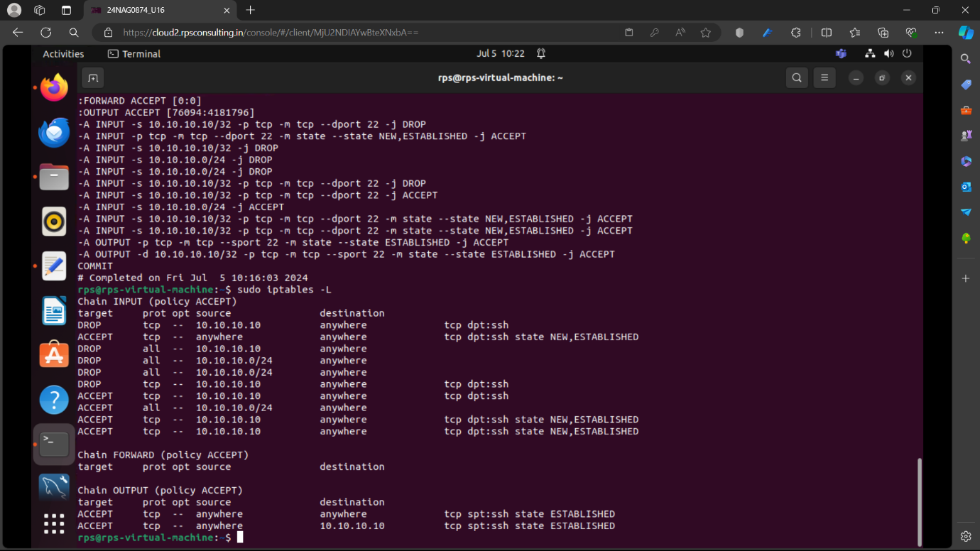
OUTPUT

Slide 15
CONCLUSION
Configuring a firewall in Linux is crucial for securing your system against unauthorized access and potential threats. By carefully setting up firewall rules, you can control incoming and outgoing network traffic, allowing only what is necessary for your system's operation while blocking or limiting everything else. This enhances the overall security posture of your Linux system by reducing the attack surface and protecting sensitive data and services.

Slide 16
THANK YOU

